Slide 1












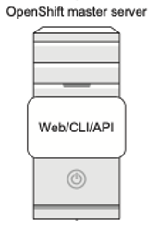



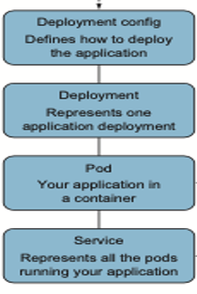









AppW Archive Data Traffic Flow and Authentication
Cloud
VPC
Jump Server
CI/CD Pipeline
Routing Layer
with Load balancer
OpenShift Cluster

Slide 2

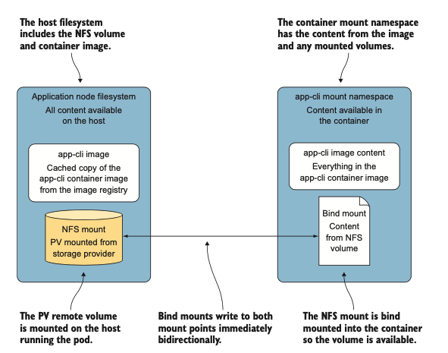
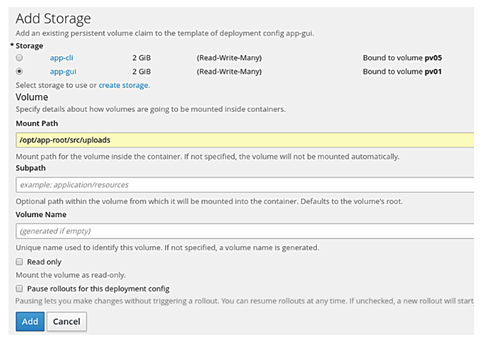
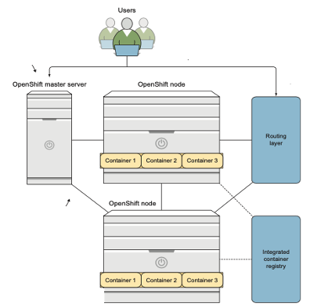
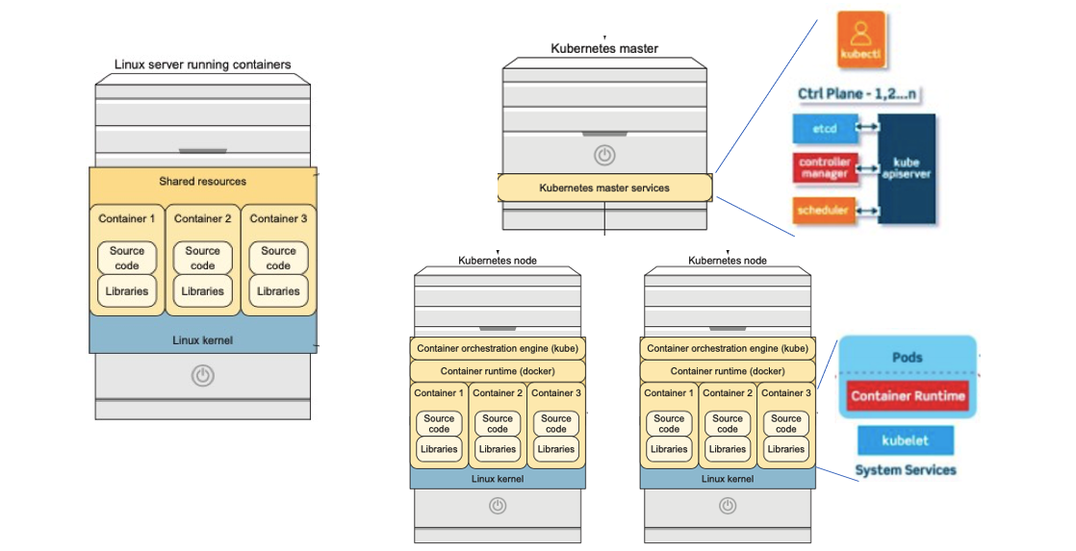
AppW Archive Creating and Managing Persistent Storage for PostgreSQL

